Slide 1
WELCOME TO THE LIVE DEMO ON ANGULAR-14
By Mr. SANJAY KUMAR

Slide 2
Introduction
I am Sanjay Samantra
7+ years of corporate experience as a front-end developer.
5+ years of experience as a trainer.

Slide 3
Training Roadmap
Course Duration : 2 months
Class Time : 1 hour daily 9.00pm to 10.00pm
Working days: Monday to Saturday (Sunday-off)
JavaScript - 2 weeks
Angular - 4 weeks
Others - 1 week(Resume, Interview, Project, Unit Testing)

Slide 4
JavaScript Content
Datatypes
Variables
Use strict
Functions
Math
String
Array
Object
OOPS
Closure
Prototypes
Call , bind , apply
Date & Time
setTimeout , setInterval
callBack , Promise , Async Await
REST Parameter
De-structuring
Modules
Generators

Slide 5
Angular Content
Angular Installation
Angular vs AngularJS
Angular CLI
Component
Module
Data binding
View Encapsulation
Inbuilt Directives
Custom Directives
Pipes
Custom Pipes
Component Communication
LifeCycle Methods / Hooks
Services
Dependency Injection
HttpClient / AJAX
Interceptors
Observables (RxJs)
Form
Routing
Lazy Loading
Build & Deploy
Unit testing

Slide 6
Course Objective / Take Away
Learn programming fundamentals and object-oriented programming concepts.
To learn new technologies
Learn to Incorporate best practices
common libraries and tools - POSTMAN, Git, GitHub, VScode, JSON-server
tools and techniques for debugging
Server Interaction (Send and receive data) using JSON and Ajax.
Enable to develop a web application using HTML, CSS, Bootstrap, JavaScript.

Slide 7
Training Highlights
Designed for both beginners & experienced candidates.
Hands on exercises
Realtime examples on every topic.
Assignments
Mock Interview
Resume preparation
Placement Assistance
Class recordings (1 year)
Notes (google classroom / GitHub)

Slide 8
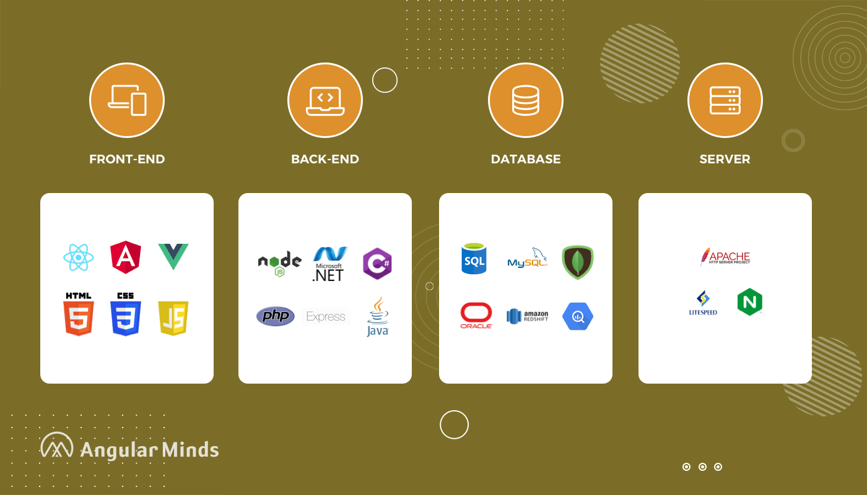
Web Development Stack

Slide 9
What is Web Development
Website Development
Front-End : User Interface (HTML, CSS, Javascript, Angular/React)
Back-End : Processing (Java, .NET, PHP, python, NodeJS)
Database : Data Storage (oracle, mysql, mongoDB)
Server : Apache Tomcat , WebLogic , Glassfish

Slide 10
Front-End Technologies
HTML | Content ( paragraph,image,table,list,audio,form,video)
CSS | Styling (color,border,width,height,background-color,positioning)
Bootstrap | predefined css , Responsiveness
Javascript | Behaviour
Angular/React/Vue | JavaScript Frameworks RAD - Rapid Application Development CLI - Command Line Interface A Template System Reusable components Synchronization of state and view Routing Form Validation Better AJAX

Slide 11
Tools & Softwares
1. browser (IE/firefox/chrome) - json viewer
2. Editor (vscode/sublimetext/atom)
3. online editors (jsbin,codepen,jsfiddle)
4. Json-server , POSTMAN ,json viewer
5. Git-software
https://git-scm.com/downloads
6. github - create profile
https://github.com/sanjaysamantra1

Slide 12
Commonly Asked Questions
Pre-Requisite - HTML , CSS
Laptop configuration - any
Mode of training - online
Fee - NareshIT Admin/management
Notes - Google Drive, GitHub
Recording - google Classroom
Admin - 8179191999(office)

Slide 13


